Slide 1
Interpreting Doctors Prescription
Using Deep Learning
Techniques
Our Team :
Rizwanullah Md
Ajay Kumar Varma N

Slide 2
Agenda :
Problem Statement
01
02
Objective’s Of Project
Literature Review
03
04
Datasets and Software Requirements
05
Architecture Diagram
06
Algorithm

Slide 3
Problem Statement
Interpreting Doctors Prescription ,notes using handwriting recognition and Deep Learning techniques
Solution to digitize the handwritten prescriptions which can also help to integrate tightly with other healthcare systems for seamless digitization and data flow.
Standardized forms can also be made machine readable with support for multiple local Indian languages to make digitization much simpler.

Slide 4
Abstraction
A Doctor’s prescription is a handwritten document written by doctors in the form of instructions that describes list of drugs for patients in time sickness, injuries and other disability problems.
While we receiving a new prescription from doctor, it is unable to understand what drug name is prescribed on it.
In most cases, however, we wouldn't be able to read it anyway because doctors use Latin abbreviations and medical terminologies on prescriptions that are not understandable by the general persons which make reading it very difficult.

Slide 5
According to the National Academy of Sciences estimates that at least 1.5 million peoples are sickened, injured or killed each year by errors while reading prescription.
We aim to resolve the problems in doctor’s prescriptions with the help of Conventional Neural Network (CNN) to recognize handwritten medicine names and return readable digital text.
We use TensorFlow Framework, and Custom Repository to match the partial string with the drug name. With Medicine Box, cases of misinterpretation of medicine names can be decreased.
This makes the ordinary persons to understand what doctor is prescribed in the prescription and also help for pharmacists.

Slide 6
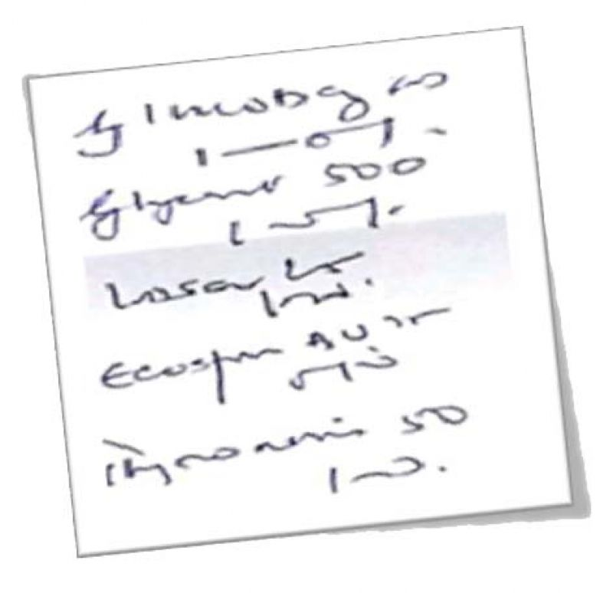
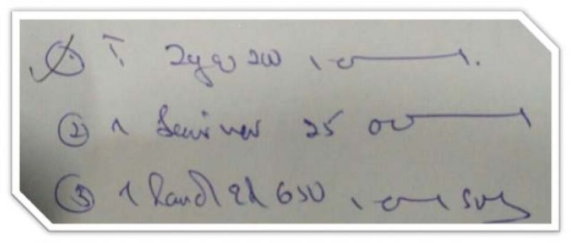
Solution
We need the picture of the doctor prescription

Slide 7
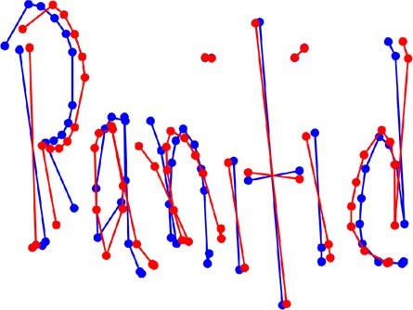
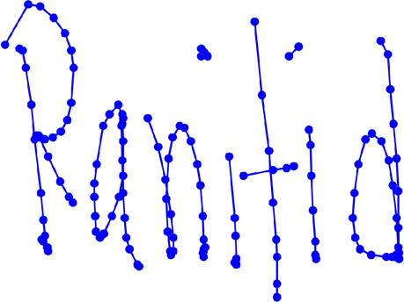
We then feed it to our model and recognize the text in it and output the text to the user.
Model Recognization the text in prescription.

Slide 8
Impact on society
The report – ‘To Err is Human’ – by the Institute of Medicine (IoM) states that medical errors cause atleast 44,000 preventable deaths annually of which 7000 deaths are due to sloppy handwriting
According to the National Academy of Sciences estimates that at least 1.5 million peoples are sickened, injured or killed each year by errors while reading prescription.
The impact of our project on society is we might be able to reduce those 7000 preventable deaths causing due to sloppy handwriting.

Slide 9
Thank You

